Slide 1


The PiXL Club The PiXL Club The PiXL Club The PiXL Club The PiXL Club The PiXL Club The PiXL Club The PiXL Club The PiXL Club The PiXL Club The PiXL Club The PiXL Club The PiXL Club The PiXL Club The PiXL Club The PiXL Club The PiXL Club The PiXL Club The PiXL Club The PiXL Club The PiXL Club The PiXL Club The PiXL Club The PiXL Club The PiXL Club The PiXL Club The PiXL Club The PiXL Club The PiXL Club The PiXL Club The PiXL Club The PiXL Club The PiXL Club The PiXL Club The PiXL Club The PiXL Club The PiXL Club The PiXL Club The PiXL Club The PiXL Club The PiXL Club The PiXL Club The PiXL Club The PiXL Club The PiXL Club XL Club The PiXL Club The PiXL Club The PiXL Club The PiXL Club The PiXL Club The PiXL Club The PiXL Club The PiXL Club The PiXL Club The PiXL Club The PiXL Club The PiXL Club The PiXL Club The PiXL Club The PiXL Club The PiXL Club The PiXL Club The PiXL Club The PiXL Club The PiXL Club The PiXL Club The PiXL Club The PiXL Club The PiXL Club The PiXL Club The PiXL Club The PiXL Club The PiXL Club The PiXL Club The PiXL Club The PiXL Club The PiXL Club The PiXL Club The PiXL Club The PiXL Club The PiXL Club The PiXL Club The PiXL Club The PiXL Club The PiXL Club The PiXL Club The PiXL Club The PiXL Club The PiXL Club The PiXL Club The PiXL Club The PiXL Club The PiXL Club The PiXL Club The PiXL Club The PiXL Club The PiXL Club The PiXL Club The PiXL Club The PiXL Club The PiXL Club The PiXL Club The PiXL Club The PiXL Club The PiXL Club The PiXL Club The PiXL Club The PiXL Club The PiXL Club The PiXL Club The PiXL Club The PiXL Club The PiXL Club The PiXL Club The PiXL Club The PiXL Club The PiXL Club The PiXL Club The PiXL Club The PiXL Club The PiXL Club The PiXL Club The PiXL Club The PiXL Club The PiXL Club The PiXL Club The PiXL Club The PiXL Club The PiXL Club The PiXL Club The PiXL Club The PiXL Club The PiXL Club The PiXL Club The PiXL Club The PiXL Club The PiXL Club The PiXL Club The PiXL Club The PiXL Club The PiXL Club The PiXL Club The PiXL Club The PiXL Club The PiXL Club The PiXL Club The PiXL Club The PiXL Club The PiXL Club The PiXL Club The PiXL Club The PiXL Club The PiXL Club The PiXL Club The PiXL Club The PiXL Club The PiXL Club The PiXL Club The PiXL Club The PiXL Club The PiXL Club The PiXL Club The PiXL Club The PiXL Club The PiXL Club The PiXL Club The PiXL Club The PiXL Club The PiXL Club The PiXL Club The PiXL Club The PiXL Club The PiXL Club The PiXL Club The PiXL Club The PiXL Club The PiXL Club The PiXL Club The PiXL Club The PiXL Club The PiXL Club The PiXL Club The PiXL Club The PiXL Club The PiXL Club The PiXL Club The PiXL Club The PiXL Club The PiXL Club The PiXL Club The PiXL Club The PiXL Club The PiXL Club The PiXL Club The PiXL Club The PiXL Club The PiXL Club The PiXL Club The PiXL Club The PiXL Club The PiXL Club The PiXL Club The PiXL Club The PiXL Club The PiXL Club The PiXL Club The PiXL Club The PiXL Club The PiXL Club The PiXL Club The PiXL Club The PiXL Club The PiXL Club The PiXL Club The PiXL Club The PiXL Club The PiXL Club The PiXL Club The PiXL Club The PiXL Club The PiXL Club The PiXL Club The PiXL Club The PiXL Club The PiXL Club The PiXL Club The PiXL Club The PiXL Club The PiXL Club The PiXL Club The PiXL Club The PiXL Club The PiXL Club The PiXL Club The PiXL Club The PiXL Club The PiXL Club The PiXL Club The PiXL Club The PiXL Club The PiXL Club The PiXL Club The PiXL Club The PiXL Club The PiXL Club The PiXL Club The PiXL Club The PiXL Club The PiXL Club The PiXL Club The PiXL Club The PiXL Club The PiXL Club The PiXL Club The PiXL Club The PiXL Club The PiXL Club The PiXL Club The PiXL Club The PiXL Club The PiXL Club The PiXL Club The PiXL Club The PiXL Club The PiXL Club The PiXL Club The PiXL Club The PiXL Club The PiXL Club The PiXL Club The PiXL Club The PiXL Club The PiXL Club The PiXL Club The PiXL Club The PiXL Club The PiXL Club The PiXL Club The PiXL Club The PiXL Club The PiXL Club The PiXL Club The PiXL Club The PiXL Club The PiXL Club The PiXL Club The PiXL Club The PiXL Club The PiXL Club The PiXL Club The PiXL Club The PiXL Club The PiXL Club The PiXL Club The PiXL Club The PiXL Club The PiXL Club The PiXL Club The PiXL Club The PiXL Club The PiXL Club The PiXL Club The PiXL Club The PiXL Club The PiXL Club The PiXL Club The PiXL Club The PiXL Club The PiXL Club The PiXL Club The PiXL Club The PiXL Club The PiXL Club The PiXL Club The PiXL Club The PiXL Club The PiXL Club The PiXL Club The PiXL Club The PiXL Club The PiXL Club The PiXL Club The PiXL Club The PiXL Club The PiXL Club The PiXL Club The PiXL Club The PiXL Club The PiXL Club The PiXL Club The PiXL Club The PiXL Club The PiXL Club The PiXL Club The PiXL Club The PiXL Club The PiXL Club The PiXL Club The PiXL Club The PiXL Club The PiXL Club The PiXL Club The PiXL Club The PiXL Club The PiXL Club The PiXL Club The PiXL Club The PiXL Club The PiXL Club The PiXL Club The PiXL Club The PiXL Club The PiXL Club The PiXL Club The PiXL Club The PiXL Club The PiXL Club The PiXL Club The PiXL Club The PiXL Club The PiXL Club The PiXL Club The PiXL Club The PiXL Club The PiXL Club The PiXL Club The PiXL Club The PiXL Club The PiXL Club The PiXL Club The PiXL Club The PiXL Club The PiXL Club The PiXL Club The PiXL Club The PiXL Club The PiXL Club The PiXL Club The PiXL Club The PiXL Club The PiXL Club The PiXL Club The PiXL Club The PiXL Club The PiXL Club The PiXL Club The PiXL Club The PiXL Club The PiXL Club The PiXL Club The PiXL Club The PiXL Club The PiXL Club The PiXL Club The PiXL Club The PiXL Club The PiXL Club The PiXL Club The PiXL Club The PiXL Club The PiXL Club The PiXL Club The PiXL Club The PiXL Club The PiXL Club The PiXL Club The PiXL Club The PiXL Club The PiXL Club The PiXL Club The PiXL Club The PiXL Club The PiXL Club The PiXL Club The PiXL Club The PiXL Club The PiXL Club The PiXL Club The PiXL Club The PiXL Club The PiXL Club The PiXL Club The PiXL Club The PiXL Club The PiXL Club The PiXL Club The PiXL Club The PiXL Club The PiXL Club The PiXL Club The PiXL Club The PiXL Club The PiXL Club The PiXL Club The PiXL Club The PiXL Club The PiXL Club The PiXL Club The PiXL Club The PiXL Club The PiXL Club The PiXL Club The PiXL Club The PiXL Club The PiXL Club The PiXL Club The PiXL Club The PiXL Club The PiXL Club The PiXL Club The PiXL Club The PiXL Club The PiXL Club The PiXL Club The PiXL Club The PiXL Club The PiXL Club The PiXL Club The PiXL Club The PiXL Club The PiXL Club The PiXL Club The PiXL Club The PiXL Club The PiXL Club The PiXL Club The PiXL Club The PiXL Club The PiXL Club The PiXL Club The PiXL Club The PiXL Club The PiXL Club The PiXL Club The PiXL Club The PiXL Club The PiXL Club The PiXL Club The PiXL Club The PiXL Club The PiXL Club The PiXL Club The PiXL Club The PiXL Club The PiXL Club The PiXL Club The PiXL Club The PiXL Club The PiXL Club The PiXL Club The PiXL Club The PiXL Club The PiXL Club The PiXL Club The PiXL Club The PiXL Club The PiXL Club The PiXL Club The PiXL Club The PiXL Club The PiXL Club The PiXL Club The PiXL Club The PiXL Club The PiXL Club The PiXL Club The PiXL Club The PiXL Club The PiXL Club The PiXL Club The PiXL Club The PiXL Club The PiXL Club The PiXL Club The PiXL Club The PiXL Club The PiXL Club The PiXL Club The PiXL Club The PiXL Club The PiXL Club The PiXL Club The PiXL Club The PiXL Club The PiXL Club The PiXL Club The PiXL Club The PiXL Club The PiXL Club The PiXL Club The PiXL Club The PiXL Club The PiXL Club The PiXL Club The PiXL Club The PiXL Club The PiXL Club The PiXL Club The PiXL Club The PiXL Club The PiXL Club The PiXL Club The PiXL Club The PiXL Club The PiXL Club The PiXL Club The PiXL Club The PiXL Club The PiXL Club The PiXL Club The PiXL Club The PiXL Club The PiXL Club The PiXL Club The PiXL Club The PiXL Club The PiXL Club The PiXL Club The PiXL Club The PiXL Club The PiXL Club The PiXL Club The PiXL Club The PiXL Club The PiXL Club The PiXL Club The PiXL Club The PiXL Club The PiXL Club The PiXL Club The PiXL Club The PiXL Club The PiXL Club The PiXL Club The PiXL Club The PiXL Club The PiXL Club The PiXL Club The PiXL Club The PiXL Club The PiXL Club The PiXL Club The PiXL Club The PiXL Club The PiXL Club The PiXL Club The PiXL Club The PiXL Club The PiXL Club The PiXL Club The PiXL Club The PiXL Club The PiXL Club The PiXL Club The PiXL Club The PiXL Club The PiXL Club The PiXL Club The PiXL Club The PiXL Club The PiXL Club The PiXL Club The PiXL Club The PiXL Club The PiXL Club The PiXL Club The PiXL Club The PiXL Club The PiXL Club The PiXL Club The PiXL Club The PiXL Club The PiXL Club The PiXL Club The PiXL Club The PiXL Club The PiXL Club The PiXL Club The PiXL Club The PiXL Club The PiXL Club The PiXL Club The PiXL Club The PiXL Club The PiXL Club The PiXL Club The PiXL Club The PiXL Club The PiXL Club The PiXL Club The PiXL Club The PiXL Club The PiXL Club The PiXL Club The PiXL Club The PiXL Club The PiXL Club The PiXL Club The PiXL Club The PiXL Club The PiXL Club The PiXL Club The PiXL Club The PiXL Club The PiXL Club The PiXL Club The PiXL Club The PiXL Club The PiXL Club The PiXL Club The PiXL Club The PiXL Club The PiXL Club The PiXL Club The PiXL Club The PiXL Club The PiXL Club The PiXL Club The PiXL Club The PiXL Club The PiXL Club The PiXL Club The PiXL Club The PiXL Club The PiXL Club The PiXL Club The PiXL Club The PiXL Club The PiXL Club The PiXL Club The PiXL Club The PiXL Club The PiXL Club The PiXL Club The PiXL Club The PiXL Club The PiXL Club The PiXL Club The PiXL Club The PiXL Club The PiXL Club The PiXL Club The PiXL Club The PiXL Club The PiXL Club The PiXL Club The PiXL Club The PiXL Club The PiXL Club The PiXL Club The PiXL Club The PiXL Club The PiXL Club The PiXL Club The PiXL Club The PiXL Club The PiXL Club The PiXL Club The PiXL Club The PiXL Club The PiXL Club The PiXL Club The PiXL Club The PiXL Club The PiXL Club The PiXL Club The PiXL Club The PiXL Club The PiXL Club The PiXL Club The PiXL Club The PiXL Club The PiXL Club The PiXL Club The PiXL Club The PiXL Club The PiXL Club The PiXL Club The PiXL Club The PiXL Club The PiXL Club The PiXL Club The PiXL Club The PiXL Club The PiXL Club The PiXL Club The PiXL Club The PiXL Club The PiXL Club The PiXL Club The PiXL Club The PiXL Club The PiXL Club The PiXL Club The PiXL Club The PiXL Club The PiXL Club The PiXL Club The PiXL Club The PiXL Club The PiXL Club The PiXL Club The PiXL Club The PiXL Club The PiXL Club
PiXL KnowIT!
GCSE Chemistry
AQA Topic – Quantitative chemistry
© Copyright The PiXL Club Ltd, 2017
This resource is strictly for the use of member schools for as long as they remain members of The PiXL Club. It may not be copied, sold nor transferred to a third party or used by the school after membership ceases. Until such time it may be freely used within the member school.
All opinions and contributions are those of the authors. The contents of this resource are not connected with nor endorsed by any other company, organisation or institution.
www.pixl.org.uk The PiXL Club Ltd, Company number 07321607

Slide 2
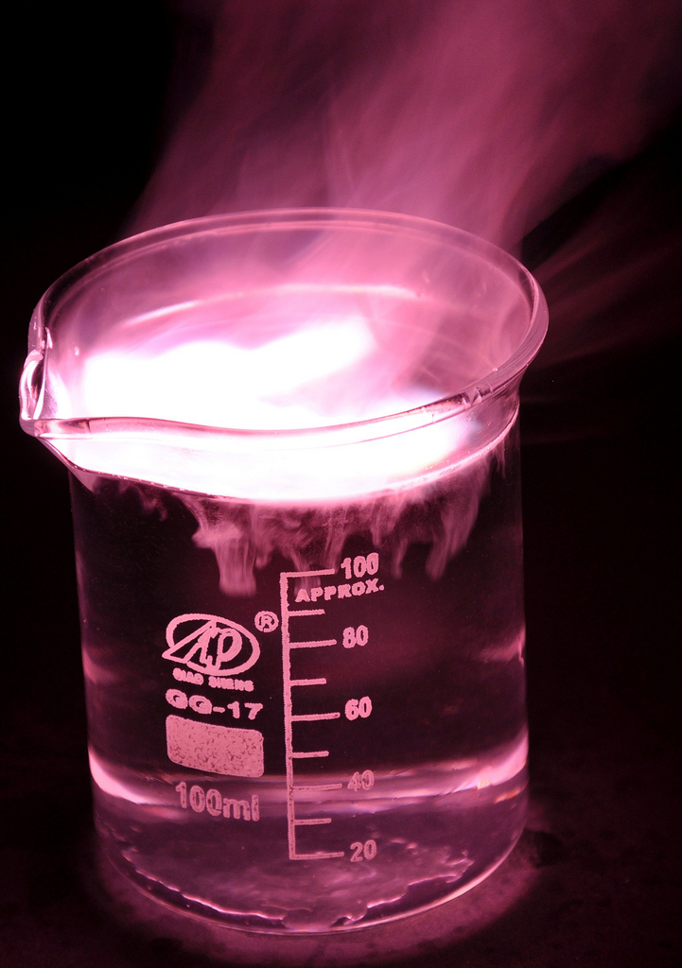
Overview
Quantitative chemistry
Chemical measurements
  Balanced chemical equations
  Conservation of mass
  Relative formula mass
Use of amount of substance (HT)
  Amounts of substances in equations (HT)
  Quantities in equations (HT)
  Using moles to balance equations (HT)
  Limiting reactants (HT)
  Concentrations of solutions
Quantities (chemistry only)
  Percentage yield
  Atom economy
  Moles of solutions and gases (HT)
Notes:
https://c2.staticflickr.com/4/3178/4076380768_03994aed44_b.jpg

Slide 3

LearnIT!
KnowIT!
Chemical Measurements
PART 1
  Balanced chemical equations
  Conservation of mass

Slide 4
  Chemical measurements - PART 1
Chemical equations can be very useful.
The law of conservation states that no atoms are lost or made during a chemical reaction so the mass of the product equals the mass of the reactants.
Chemical reactions can be represented by symbol equations which are balanced in terms of the numbers of atoms of each element involved on both sides of the equation.
State symbols s, l, g and aq are used in symbol equations.
When hydrogen molecules react with chlorine molecules, they make hydrogen chloride molecules:
H₂ + Cl₂ → HCl
This equation shows the reactants and products, but it is not balanced.
H₂ + Cl₂ → 2HCl
This balanced equation shows that one hydrogen molecules reacts with one chlorine molecule to form two molecules of hydrochloric acid.

Slide 5
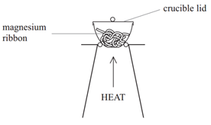
  Chemical measurements - PART 1
When magnesium is heated in a crucible it reacts with oxygen and forms magnesium oxide:
2Mg + O₂ → 2MgO
This equation shows that two magnesium atoms react with one oxygen molecule to form two magnesium oxide compounds.
Here are the results from the reaction:
Some reactions may appear to involve a change in mass but this can be explained because a reactant or product is usually a gas and its mass has not been taken into account.
In this example, the mass of the magnesium oxide produced is greater than the mass of the original metal.
 | Mass in g
Mass of crucible at the start of the reaction | 0.23
Mass of crucible at end of reaction | 0.41
Notes:
http://www.tutormyself.com/wp-content/uploads/img_56ad15facc33b.png

Slide 6
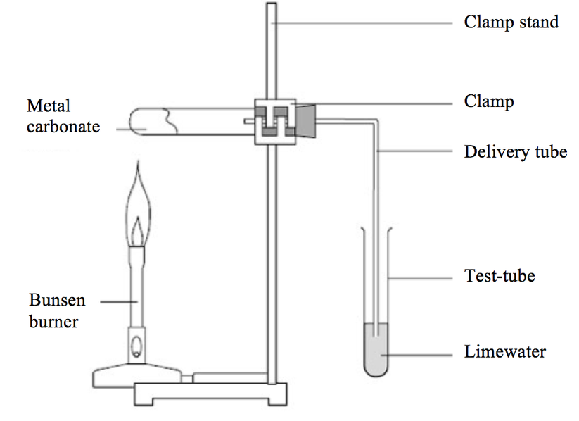
  Chemical measurements - PART 1
When calcium carbonate thermally decomposes it forms calcium oxide and carbon dioxide:
CaCO₃ → CaO + CO₂
This equation shows that one calcium carbonate compound (made from one calcium, one carbon and three oxygen atoms) forms one calcium oxide compound and one carbon dioxide molecule.
Here are the results from the reaction:
In thermal decomposition of metal carbonates, carbon dioxide is produced and escapes into the atmosphere leaving the metal oxide as the only solid product.
In this example, the mass of the calcium oxide produced is less than the mass of the metal carbonate formed.
 | Mass in g
Mass of metal carbonate at the start of the reaction | 0.54
Mass of metal carbonate at end of reaction | 0.36
Whenever a measurement is taken, there is always some uncertainty about the result obtained that may have come from a variety of sources within the investigation. It is useful to determine whether the mean value falls within the range of uncertainty of the result.
Notes:
https://www.google.co.uk/url?sa=i&rct=j&q=&esrc=s&source=images&cd=&cad=rja&uact=8&ved=0ahUKEwi29vnf7MLVAhUIzIMKHf0PBCwQjRwIBw&url=http%3A%2F%2Figcsechemistryrevision.weebly.com%2Fthe-periodic-table&psig=AFQjCNHbIyDlYCiPV-LD2cObgR3YO4wosA&ust=1502117113201934

Slide 7
  Chemical measurements - PART 1
When calcium carbonate thermally decomposes it forms calcium oxide and carbon dioxide:
CaCO₃ → CaO + CO₂
This equation shows that one calcium carbonate compound (made from one calcium, one carbon and three oxygen atoms) forms one calcium oxide compound and one carbon dioxide molecule.
Here are the results from the reaction:
In thermal decomposition of metal carbonates, carbon dioxide is produced and escapes into the atmosphere leaving the metal oxide as the only solid product.
In this example, the mass of the calcium oxide produced is less than the mass of the metal carbonate formed.
 | Mass in g
Mass of metal carbonate at the start of the reaction | 0.54
Mass of metal carbonate at end of reaction | 0.36
Whenever a measurement is taken, there is always some uncertainty about the result obtained that may have come from a variety of sources within the investigation. It is useful to determine whether the mean value falls within the range of uncertainty of the result.
Notes:
https://www.google.co.uk/url?sa=i&rct=j&q=&esrc=s&source=images&cd=&cad=rja&uact=8&ved=0ahUKEwi29vnf7MLVAhUIzIMKHf0PBCwQjRwIBw&url=http%3A%2F%2Figcsechemistryrevision.weebly.com%2Fthe-periodic-table&psig=AFQjCNHbIyDlYCiPV-LD2cObgR3YO4wosA&ust=1502117113201934

Slide 8

QuestionIT!
Chemical Measurements
PART 1
  Balanced chemical equations
  Conservation of mass

Slide 9
  Chemical measurements – QuestionIT
What is the law of conservation of mass?
Why might some reactions appear to show a change in mass?
Give two examples of a reaction where a change in mass may appear to take place.
Balance the following equations:
  H₂ + O₂ → H₂O
  Ca + HCl → CaCl₂ + H₂
  Li + H₂O → LiOH + H₂
  NH₃ + O₂ → NO + H₂O
  K + O₂ → K₂O

Slide 10
  Chemical measurements – QuestionIT
How many atoms and elements are in the compound sodium aluminate, NaAl(OH)₄?
What do the following formulae tell you?
a) 2HCl
b) Cl₂
An aqueous solution of hydrogen peroxide (H₂O₂) decomposes to form water and oxygen.
a) Write a balanced symbol equation for this reaction. Include
the state symbols.
b) Why does the water, produced during the reaction, have a lower mass than the original hydrogen peroxide?

Slide 11

AnswerIT!
Chemical Measurements
PART 1
  Balanced chemical equations
  Conservation of mass

Slide 12
  Chemical measurements – QuestionIT
What is the law of conservation of mass?
  Mass of reactants = mass products.
Why might some reactions appear to show a change in mass?
  A reactant or a product is a gas.
Give two examples of a reaction where a change in mass may appear to take place.
  Metal reacting with oxygen or an acid. Thermal decomposition.
Balance the following equations:
  2H₂ + O₂ → 2H₂O
  Ca + 2HCl → CaCl₂ + H₂
  2Li + 2H₂O → 2LiOH + H₂
  4NH₃ + 5O₂ → 4NO + 6H₂O
  4K + O₂ → 2K₂O

Slide 13
  Chemical measurements – QuestionIT
How many atoms and elements are in the compound sodium aluminate, NaAl(OH)₄?
Four elements and ten atoms.
2. What do the following formulae tell you?
a) 2HCl
Two molecules of hydrogen chloride. Each molecule contains one hydrogen atom and one chlorine atom
b) Cl₂
One molecule of chlorine made of two atoms.
An aqueous solution of hydrogen peroxide (H₂O₂) decomposes to form water and oxygen.
a) Write a balanced symbol equation for this reaction. Include
the state symbols.
2H₂O₂ (aq) → 2H₂O (l) + O₂(g)

Slide 14
  Chemical measurements – QuestionIT
b) Why does the water, produced during the reaction, have a lower mass than the original hydrogen peroxide?
Because the oxygen gas produced during the reaction escaped into the atmosphere.

Slide 15
LearnIT!
KnowIT!
Chemical Measurements
PART 2
  Relative formula mass

Slide 16
  Chemical measurements - PART 2
Relative formula mass (M_{r}) of a compound is the sum of the relative atomic masses of the atoms in the numbers shown in the formula.
The relative atomic masses can be found in the periodic table
In a balanced chemical equation, the sum of the relative formula masses of the reactants equals the sum of the relative formula masses of the products.
For example: 2Mg + O₂ → 2MgO
(2x24) + (2x16) → 2 x (24+16)
80 → 80
NaCl
(1 x Na + 1 x Cl)
A_{r}: Na (23) Cl (35.5)
M_{r} = 23 + 35.5 = 58.5
H₂O
(2 x H + 1 x O)
A_{r}: H (1) O (16)
M_{r} = (1 x 2) + 16 = 18
H₂SO₄
(2 x H + 1 x S + 4 x O)
A_{r}: H (1) S (32) O (16)
M_{r} = (1x2) + 32 + (16x4) = 98
Al₂(SO₄)₃
(2 x Al + 3 x S + 12 x O)
A_{r}: Al (27) S (32) O (16)
M_{r} = (27x2) + (32x3) + (16x12) = 342

Slide 17
QuestionIT!
Chemical Measurements
PART 2
  Relative formula mass

Slide 18
  Chemical measurements– QuestionIT
What is the relative formula mass of a compound?
What is the relative formula mass of:
a) MgCl₂
b) C₆H₁₂O₆
What can be said about the sum of the relative formula masses of the reactants and products of a reaction?
Why can you have relative atomic masses which are not whole numbers e.g. chlorine is 35.5?

Slide 19
AnswerIT!
Chemical Measurements
PART 2
  Relative formula mass

Slide 20
  Chemical measurements– QuestionIT
What is the relative formula mass of a compound?
  Sum of the relative atomic masses of the atoms in the numbers shown in the formula.
What is the relative formula mass of:
a) MgCl₂ 95
b) C₆H₁₂O₆ 180
What can be said about the sum of the relative formula masses of the reactants and products of a reaction?
  In a balanced chemical equation – the sum of the relative formula masses of the reactants in the quantities shown = sum of the relative formula masses of the products in the quantities shown.

Slide 21
  Chemical measurements– QuestionIT
Why can you have relative atomic masses which are not whole numbers e.g. chlorine is 35.5?
  Isotopes.

Slide 22
LearnIT!
KnowIT!
Use of amount of
substance
PART 1
  Moles (HT)
  Amounts of substances in equations (HT)
  Quantities in equations (HT)
  Using moles to balance equations (HT)
  Limiting reactants (HT)

Slide 23
  Use of amount of substance - PART 1
Chemical amounts are measured in moles. The symbol for the unit mole is mol.
The mass of one mole of a substance in grams is numerically equal to its relative formula mass. One mole of a substance contains the same number of the stated particles, atoms, molecules or ions as one mole of any other substance.
The number of atoms, molecules or ions in a mole of a given substance is the Avogadro constant. The value of the Avogadro constant is 6.02 x 10²³ per mole.
Number of moles = mass (g) or mass (g)
A_{r} M_{r}
Mass (g) = number of moles x A_{r}
or number of moles x M_{r}
How many moles of sulfuric acid molecules are there in 4.7g of sulfuric acid (H₂SO₄)? Give your answer to 1 significant figure.
4.7 = 0.05 mol
98
What is the mass of 7.2 x 10⁻³ moles of aluminium sulfate (Al₂(SO₄)₃)? Give your answer to 1 decimal place.
7.2 x 10⁻³ x 342 = 2.5g

Slide 24
  Use of amount of substance - PART 1
  HIGHER TIER
The masses of reactants and products can be calculated from balanced symbol equations.
Chemical equations can be interpreted in terms of moles. Example:
H₂ + Cl₂ → 2HCl
This equation shows that one mole of hydrogen reacts with one mole of chlorine to form two moles of hydrochloric acid.
The balanced equation is useful because it can be used to calculate what mass of hydrogen and chlorine react together and how much hydrogen chloride is made.
A_{r}: H (1) so mass of 1 mole of H₂ = 2 x 1 = 2g
A_{r}: Cl (35.5) so mass of 1 mole of Cl₂ = 35.5 x2 = 71g
M_{r} : HCl (1 + 35.5) so mass of 1 mole of HCl = 36.5g
The balanced equation tells us that one mole of hydrogen reacts with one mole of chlorine to give two moles of hydrogen chloride molecules, so turning this to masses:
1 mole of hydrogen = 1 x 2 = 2g
1 mole of chlorine = 1 x 71 = 71g
2 moles of hydrochloric acid = 2 x 36.5 = 73g

Slide 25
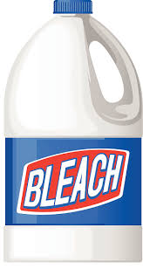
  Use of amount of substance - PART 1
  HIGHER TIER
Sodium hydroxide reacts with chlorine to make bleach:
2NaOH + Cl₂ → NaOCl + NaCl + H₂O
If you have a solution containing 100.0g of sodium
hydroxide, what mass of chlorine gas do you need to
convert it to bleach?
M_{r} : NaOH (23 + 16 + 1) so mass of 1 mole of NaOH = 40g
M_{r} : Cl₂ (35.5 x 2) so mass of 1 mole of Cl₂ = 71g
So 100.0g of sodium hydroxide is 100/40 = 2.5 moles
The balanced symbol equation tells us that for every two moles of sodium hydroxide, you need one mole of chlorine to react with it.
So you need 2.5/2 = 1.25 moles of chlorine
One mole of chlorine is 71g, so you will need 1.25 x 71g = 88.75g of chlorine to react with 100.0g of sodium hydroxide.
Notes:
https://www.google.co.uk/url?sa=i&rct=j&q=&esrc=s&source=images&cd=&cad=rja&uact=8&ved=0ahUKEwj-vJir4MTVAhXrBsAKHWkWDJ4QjRwIBw&url=http%3A%2F%2Fclipart-library.com%2Fbleach-bottle-cliparts.html&psig=AFQjCNEwZrD7GTPhfnI4-VkcrXeeVO_Fcw&ust=1502182494697836

Slide 26
  Use of amount of substance - PART 1
  HIGHER TIER
The balancing numbers in a symbol equation can be calculated from the masses of reactants and products by converting the masses in grams to amounts in moles and converting the number of moles to simple whole number ratios.
8.5g of sodium nitrate (NaNO₃) is heated until its mass is constant.
6.9g of sodium nitrite (NaNO₂) and 1.6g of oxygen gas (O₂) is produced.
NaNO₃ → NaNO₂ + O₂
M_{r}: NaNO₃ = 23 + 14 + (16x3) = 85
M_{r}: NaNO₂ = 23 + 14 + (16x2) = 69
M_{r}: O₂ = 16x2 = 32
Then to convert masses to moles use:
Moles of NaNO₃ = 8.5/85 = 0.1 mol
Moles of NaNO₂ = 6.9/69 = 0.1 mol
Moles of O₂ = 1.6/32 = 0.05 mol
Dividing the ratio by the smallest number gives 2:2:1 2NaNO₃ → 2NaNO₂ + O₂
Number of moles = mass (g)
M_{r}
NaNO₃ : NaNO₂ : O₂
0.1 : 0.1 : 0.05

Slide 27
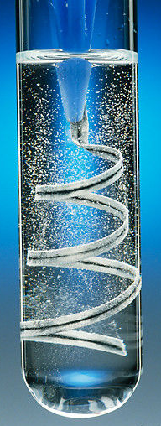
  Use of amount of substance - PART 1
  HIGHER TIER
In a chemical reaction involving two reactants, it is common to use an excess of one of the reactants to ensure that all the reactant is used up. The reactant that is completely used up is called the limiting reactant because it limits the amount of products.
4.8g of magnesium ribbon reacts with 7.3g of HCl.
Which is the limiting reactant?
Mg(s) + 2HCl(aq) → MgCl₂(aq) + H₂(g)
A_{r}: Mg (24) and A_{r}: Cl (35.5)
4.8g of Mg = 4.8/24 moles = 0.2 mol
7.3g of HCl = 7.3/36.5 moles = 0.2 mol
From the balanced equation:
1 mole of Mg reacts with 2 moles of HCl,
therefore 0.2 mol of Mg will need 0.4 mol of HCl to react completely, there is only 0.2 mol of HCl, so the HCl is the limiting reactant.
Notes:
https://www.google.co.uk/url?sa=i&rct=j&q=&esrc=s&source=images&cd=&cad=rja&uact=8&ved=0ahUKEwipmbLB4MTVAhVMCcAKHRezDfYQjRwIBw&url=http%3A%2F%2Fthaydungdayhoa.com%2Fvideo-clip%2Fmagie-tac-dung-voi-dung-dich-axit-clohydric.html&psig=AFQjCNGLBqWTLdXFIBC5sgzgj1iDJR1bVg&ust=1502182612745360

Slide 28
QuestionIT!
Use of amount of
substance
PART 1
  Moles (HT)
  Amounts of substances in equations (HT)
  Quantities in equations (HT)
  Using moles to balance equations (HT)
  Limiting reactants (HT)

Slide 29
  Use of amount of substance (HT) – QuestionIT
What is meant by the term ‘mole’?
What is the symbol for the unit mole?
What does ‘Avogadro’s constant’ tell us?
What is the value for Avogadro’s constant?
How many atoms in 1 mole of carbon?

Slide 30
  Use of amount of substance (HT) – QuestionIT
How many atoms in 1 mole of chlorine gas, Cl₂?
What can the following equation tell us about the number of moles of each substance?
Mg + 2HCl → MgCl₂ + H₂
What is meant by the term ‘limiting reactant’?

Slide 31
  Use of amount of substance (HT) – QuestionIT
How many moles of helium atoms are there in 0.04g of helium?
What is the mass of 20 moles of calcium carbonate CaCO₃?
Answer in kg.
Calcium carbonate decomposes to calcium oxide in a kiln in the following reaction: CaCO₃ → CaO + CO₂
Calculate the mass of calcium oxide that can be produced when
300 tonnes of calcium carbonate is heated.

Slide 32
  Use of amount of substance (HT) – QuestionIT
0.10g of hydrogen reacts with 3.55g of chlorine to produce 3.65g of hydrogen chloride. Use this information to work out the balancing numbers for hydrogen chloride.
H₂ + Cl₂ → ___HCl

Slide 33
  Use of amount of substance (HT) – QuestionIT
If 4.95 g of ethene (C₂H₄) are combusted with 3.25 g of oxygen, what is the limiting reactant?
C₂H₄ + 3O₂ → 2CO₂ + 2H₂O

Slide 34
AnswerIT!
Use of amount of
substance
PART 1
  Moles (HT)
  Amounts of substances in equations (HT)
  Quantities in equations (HT)
  Using moles to balance equations (HT)
  Limiting reactants (HT)

Slide 35
  Use of amount of substance (HT) – QuestionIT
What is meant by the term ‘mole’?
  A measure of the chemical amount of a substance.
What is the symbol for the unit mole?
  mol
What does ‘Avogadro’s constant’ tell us?
  Number of atoms, molecules or ions in a mole of a substance.
What is the value for Avogadro’s constant?
  6.02 x 10²³ per mol
How many atoms in 1 mole of carbon?
  6.02 x 10²³

Slide 36
  Use of amount of substance (HT) – QuestionIT
How many atoms in 1 mole of chlorine gas, Cl₂?
  6.02 x 10²³
What can the following equation tell us about the number of moles of each substance?
Mg + 2HCl → MgCl₂ + H₂
  1 mole of magnesium reacts with 2 moles of hydrochloric acid to form 1 mole of magnesium chloride and 1 mole of hydrogen.
What is meant by the term ‘limiting reactant’?
  A reactant in a reaction which is completely used up when the other reactant is in excess.

Slide 37
  Use of amount of substance (HT) – QuestionIT
How many moles of helium atoms are there in 0.04g of helium?
0.04/4 = 0.01mol
What is the mass of 20 moles of calcium carbonate CaCO₃?
Answer in kg.
40+12+(16x3) = 100
100 x 20 = 2,000g = 2kg.
Calcium carbonate decomposes to calcium oxide in a kiln in the following reaction: CaCO₃ → CaO + CO₂
Calculate the mass of calcium oxide that can be produced when
300 tonnes of calcium carbonate is heated.
Relative formula mass of calcium carbonate = 100 = 100g
Relative formula mass of calcium oxide = 56 = 56g
100 tonnes of calcium carbonate makes 56 tonnes of calcium oxide
so 300 tonnes make 168 tonnes

Slide 38
  Use of amount of substance (HT) – QuestionIT
0.10g of hydrogen reacts with 3.55g of chlorine to produce 3.65g of hydrogen chloride. Use this information to work out the balancing numbers for hydrogen chloride.
H₂ + Cl₂ → ___HCl
M_{r}: H₂ = 1 x 2 = 2
M_{r}: Cl₂ = 35.5 x 2 = 71
M_{r}: HCl = 1 + 35.5 = 36.5
Then to convert masses to moles use:
Moles of H₂ = 0.10/2 = 0.05 mol
Moles of Cl₂ = 3.55/71 = 0.05 mol
Moles of HCl = 3.65/36.5 = 0.1 mol
Dividing the ratio by the smallest number gives 1:1:2
H₂ + Cl₂ → 2HCl

Slide 39
  Use of amount of substance (HT) – QuestionIT
If 4.95 g of ethene (C₂H₄) are combusted with 3.25 g of oxygen, what is the limiting reactant?
C₂H₄ + 3O₂ → 2CO₂ +2H₂O
M_{r}: C₂H₄ = 28
M_{r}: O₂ = 32
4.95/28 = 0.177 mol
3.25/32 = 0.102 mol
From the equation: 1 mole of ethene reacts with 3 moles of
oxygen. In this case 0.177 mol of ethene will need 0.53 mol of
oxygen to react, which we do not have, so oxygen is the limiting
factor.

Slide 40
LearnIT!
KnowIT!
Use of amount of substance
PART 2
  Concentration of solutions

Slide 41
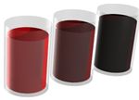
  Calculations - PART 2
Chemists quote the amount of substance (solute) dissolved in a certain volume of the solution. The units used to express the concentration can be grams per decimetre cubed (g/dm³). A decimetre (1dm ³) cubed is equal to 1000cm³.
The blackcurrant juice is getting more concentrated – the darker colour indicates more squash is in the same volume of its solution
If you know the mass of the solute dissolved in a certain volume of solution, you can work out the concentration using:
Concentration = amount of solute (g)
(g/dm³ ) Volume of solution (dm³)
Remember if you are using cm³ to multiply the volume by 1000 to covert to dm³
Example 1:
50g of sodium hydroxide is dissolved in water to make up 200cm³ .
What is the concentration in dm³?
50g/200cm³= 0.25g/cm³
0.25g/cm³ x 1000 = 250g/dm³

Slide 42
  Calculations - PART 2
Example 2:
A solution of sodium chloride has a concentration of 200g/dm³.
What is the mass of sodium chloride in 700cm³ of solution?
Convert 700cm³ into dm³
700/1000 = 0.7 dm³
Then rearrange the equation
amount of solute = concentration x volume of solution
(g) (g/dm³) (dm³)
200g/dm³ x 0.7 dm³ = 140g
HIGHER:
You can increase the concentration of an aqueous solution by:
Adding more solute and dissolving it in the same volume of its solution.
Evaporating off some of the water from the solution so you have the same mass of solute in a smaller volume of solution.

Slide 43
QuestionIT!
Use of amount of substance
PART 2
  Concentration of solutions

Slide 44
  Use of amount of substance – QuestionIT
What units can be used for the concentration of a solution?
What does dm³ mean?
Give the equation for calculating concentration from the mass of substance and volume of solution.
HT Only: How can you increase the concentration of an aqueous solution?

Slide 45
  Use of amount of substance – QuestionIT
Calculate the concentration in g/dm³ for 50g of sodium chloride in 2.5 dm³ of water.
Calculate the concentration in g/dm³ of 1.4g of potassium carbonate in 855cm³ of water.
A teacher has a solution of lithium fluoride with a concentration of 72.6g/dm³. Calculate the mass of lithium fluoride dissolved in 25.0cm³ of solution.

Slide 46
AnswerIT!
Use of amount of substance
PART 2
  Concentration of solutions

Slide 47
  Use of amount of substance – QuestionIT
What units can be used for the concentration of a solution?
  g/dm³
What does dm³ mean?
  1000cm³
Give the equation for calculating concentration from the mass of substance and volume of solution.
  Concentration = mass ÷ volume
HT Only: How can you increase the concentration of an aqueous solution?
  Add more solute and dissolve in the same volume of water; evaporate off some of the water/decrease the volume of water

Slide 48
  Use of amount of substance – QuestionIT
Calculate the concentration in g/dm³ for 50g of sodium chloride in 2.5dm³ of water.
50/2.5 = 20g/dm³
Calculate the concentration in g/dm³ of 1.4g of potassium carbonate in 855cm³ of water.
(1.4/855) x 1000 = 1.64 g/dm³
A teacher has a solution of lithium fluoride with a concentration of 72.6g/dm³. Calculate the mass of lithium fluoride dissolved in 25.0cm³ of solution.
25cm³ = 0.025dm³
72.6 x 0.025 = 1.8g

Slide 49
LearnIT!
KnowIT!
Yield and
atom economy
CHEMISTRY ONLY
  Percentage yield
  Atom economy

Slide 50
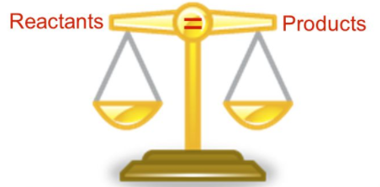
  Yield and atom economy - CHEMISTRY ONLY
Even though no atoms are gained or lost in a chemical reaction, it is not always possible to obtain the calculated amount of product because:
The reaction may not go to completion because it is reversible
Some of the product may be lost when it is separated from the reaction mixture
Some of the reactants may react in ways different to the expected reactions
The amount of product obtained is known as the yield.
The theoretical yield is the maximum calculated amount of a product that could be formed from a given amount of reactants.
The actual yield is the actual amount of product obtained from a chemical reaction.
Notes:
https://www.google.co.uk/url?sa=i&rct=j&q=&esrc=s&source=images&cd=&ved=0ahUKEwjSltDYrsPVAhWrKsAKHRnNB70QjRwIBw&url=http%3A%2F%2Fslideplayer.com%2Fslide%2F3592418%2F&psig=AFQjCNHGiju0DEs91_r5gjgI3eDgDsEfaA&ust=1502134825976090

Slide 51
  Yield and atom economy - CHEMISTRY ONLY
When compared with the maximum theoretical amount as a percentage, it is called the percentage yield and is calculated as:
Percentage yield = mass of product actually made x 100
maximum theoretical mass of product
A piece of sodium metal is heated in chlorine gas. A maximum theoretical mass of 10g for sodium chloride was calculated, but the actual yield was only 8g.
Calculate the percentage yield.
Percentage yield = 8/10 x 100
= 80%
This means the percentage yield is 80%
HIGHER:
200g of calcium carbonate is heated. It decomposes to make calcium oxide and carbon dioxide. Calculate the theoretical mass of calcium oxide made.
CaCO₃ → CaO + CO₂
M_{r} of CaCO₃ = 40 + 12 + (16x3) = 100
M_{r} of CaO = 40 + 16 = 56
100g of CaCO₃ would make 56 g of CaO
So 200g would make 112g

Slide 52
  Yield and atom economy - CHEMISTRY ONLY
The atom economy (atom utilisation) is a measure of the amount of starting materials that end up as useful products. It is important for sustainable development and for economic reasons to use reactions with high atom economy. The percentage atom economy is calculated using a balanced equation for the reaction as follows:
Relative formula mass of desired product from equation x 100
Sum of relative formula mass of all reactants from equation
Example:
Calculate the atom economy for making hydrogen by reacting zinc with hydrochloric acid:
Zn + 2HCl → ZnCl₂ + H₂
M_{r} of H₂ = 1 + 1 = 2
M_{r} of ZnCl₂ = 65 + 35.5 + 35.5 = 136
Atom economy = ²∕₁₃₆ ₊ ₂ × 100
= ²∕₁₃₈ × 100 = 1.45%
This method is unlikely to be chosen as it has a low atom economy.
The less waste there is, the higher the atom economy, the less materials are wasted, less energy used, so making the process more economic, 'greener' and sustainable.

Slide 53
QuestionIT!
Yield and
atom economy
PART 1
CHEMISTRY ONLY
  Percentage yield
  Atomy economy

Slide 54
  Yield and atom economy (Chemistry only) – QuestionIT
What is meant by the term ‘yield’?
What is the equation for calculating percentage yield?
Give 2 reasons why it is not always possible to obtain the expected amount of product from a reaction.
What is meant by the term ‘atom economy’?
Why is it important to use reactions with high atom economy?
What is the equation for calculating the percentage atom economy from a balanced chemical equation?

Slide 55
  Yield and atom economy (Chemistry only) – QuestionIT
Magnesium is heated in air to make magnesium oxide. Suggest why the actual yield might be less than the maximum theoretical yield.
In the neutralisation of sulfuric acid with sodium hydroxide, the theoretical yield from 13.8g of sulfuric acid is 20g. In a synthesis, the actual yield is 17.4g. What is the percentage yield for this synthesis?

Slide 56
  Yield and atom economy (Chemistry only) – QuestionIT
Calculate the atom economy for making hydrogen from methane
and steam.
CH₄ + 2H₂O → CO₂ + 4H₂

Slide 57
AnswerIT!
Yield and
atom economy
PART 1
CHEMISTRY ONLY
  Percentage yield
  Atomy economy

Slide 58

  Yield and atom economy (Chemistry only) – QuestionIT
What is meant by the term ‘yield’?
  Amount of product obtained.
What is the equation for calculating percentage yield?
  % yield = $\frac{mass of product actually made }{Maximum theoretical mass of product}$ x 100
Give 2 reasons why it is not always possible to obtain the expected amount of product from a reaction.
  Reaction may not go to completion as it is reversible; some product may be lost; some reactants may react differently to expected.
What is meant by the term ‘atom economy’?
  Measure of the amount of starting materials that end up as useful products.

Slide 59
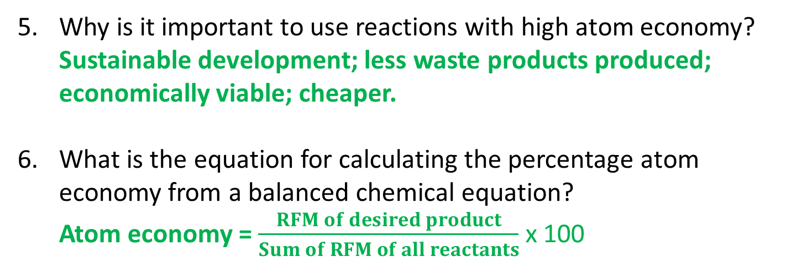
  Yield and atom economy (Chemistry only) – QuestionIT
Why is it important to use reactions with high atom economy?
  Sustainable development; less waste products produced; economically viable; cheaper.
What is the equation for calculating the percentage atom economy from a balanced chemical equation?
  Atom economy = $\frac{RFM of desired product}{Sum of RFM of all reactants}$ x 100

Slide 60
  Yield and atom economy (Chemistry only) – QuestionIT
Magnesium is heated in air to make magnesium oxide. Suggest why the actual yield might be less than the maximum theoretical mass.
Magnesium nitride is formed as well as the magnesium oxide
expected/some of the oxide might escape as smoke/not all the
magnesium reacts.
In the neutralisation of sulfuric acid with sodium hydroxide, the theoretical mass from 13.8g of sodium sulfate is 20g. In a synthesis, the actual yield is 17.4g. What is the percentage yield for this synthesis?
Percentage yield = (actual yield ÷ theoretical mass) × 100
Percentage yield = (17.4 ÷ 20) x 100 = 87%

Slide 61
  Yield and atom economy (Chemistry only) – QuestionIT
Calculate the atom economy for making hydrogen from methane
and steam.
CH₄ + 2H₂O → CO₂ + 4H₂
M_{r} of H₂O = (1 x 2) + 16 = 18
18 x 2 = 36
M_{r} of CH₄ = 12 + (1 x 4) = 16
Atom economy = ^{4 × 2}∕₃₆ ₊ ₁₆ × 100
= ⁸∕₅₂ × 100 = 15.4%

Slide 62
LearnIT!
KnowIT!
Quantities
CHEMISTRY ONLY
  Moles of solution and gases (HT)

Slide 63
  Quantities – CHEMISTRY ONLY
  Higher
The concentration of a solution is the amount of solute per volume of solution.
Chemists measure concentration in moles per cubic decimetre (mol/dm³).
Concentration = amount (mol)
(mol/dm³) volume (dm³)
Example 1:
Example 2:
What is the concentration of a solution that has 35.0g of solute in 0.5dm³of solution?
35/0.5 = 70 g/dm³
Calculate the mass of magnesium chloride (MgCl₂) if there is 1 dm³ of a 1mol/ dm³ solution.
Mass of 1 mole of magnesium chloride = 24 + (35.5 × 2) = 95 g
So there are 95 g of magnesium chloride in 1 dm³ of a 1 mol/dm³ solution.

Slide 64
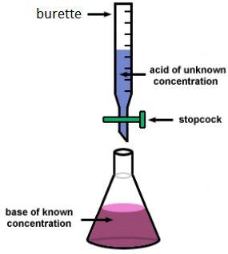
  Quantities - CHEMISTRY ONLY
  Higher
If the volumes of two solutions that react completely are known and the concentrations of one solution is known, the concentration of the other solution can be calculated.
2NaOH(aq) + H₂SO₄(aq)→ Na₂S0₄(aq) + 2H₂O(l)
It takes 12.20cm³ of sulfuric acid to neutralise 24.00cm³ of sodium hydroxide solution, which has a concentration of 0.50mol/dm³.
Calculate the concentration of the sulfuric acid in g/dm³
0.5 mol/dm³ x (24/1000) dm³ = 0.012 mol of NaOH
The equation shows that 2 mol of NaOH reacts with 1 mol of H₂SO₄, so the number of moles in 12.20cm³ of sulfuric acid is (0.012/2) = 0.006 mol of sulfuric acid
Calculate the concentration of sulfuric acid in mol/ dm³
0.006 mol x (1000/12.2) dm³ =0.49mol/dm³
Calculate the concentration of sulfuric acid in g/ dm³
H₂SO₄ = (2x1) + 32 + (4x16) = 98g
0.49 x 98g = 48.2g/dm³
Notes:
https://www.google.co.uk/url?sa=i&rct=j&q=&esrc=s&source=images&cd=&cad=rja&uact=8&ved=0ahUKEwic9fD53sTVAhXXFsAKHSJ7Dr8QjRwIBw&url=https%3A%2F%2Fdashboard.dublinschools.net%2Flessons%2F%3Fid%3De9c698fd6c35d97ff2e23fd627aef61a&psig=AFQjCNEPUZuHN4PUAqRXuixkOonJ1d2CJw&ust=1502182150450095

Slide 65
  Quantities - CHEMISTRY ONLY
  Higher
Equal amounts of moles or gases occupy the same volume under the same conditions of temperature and pressure. The volume of one mole of any gas at room temperature and pressure (rtp) (20°C and 1 atmospheric pressure) is 24 dm³.
You can calculate the volume of a gas at room temperature and pressure from its mass and relative formula mass using the equation:
Number of moles = mass
relative formula mass
Volume of gas at rtp = moles x 24
You can calculate the volumes of gaseous reactants and products from a balanced equation and a given volume of a gaseous reactant or product using the following equation:
Volume of gas at rtp = number of moles x molar mass
volume (24 dm³)

Slide 66
  Quantities - CHEMISTRY ONLY
  Higher
What is the volume of 3.5g of hydrogen?
A_{r} : H (1)
M_{r} : H₂ = 2
1 mole in g = 2g
3.5/2 = 1.75 mol
volume H₂ = 1.75 x 24 = 42 dm³
6g of a hydrocarbon gas had a volume of 4.8 dm³. Calculate its molecular mass.
1 mole = 24 dm³, so 4.8/24 = 0.2 mol
M_{r} = 6 / 0.2 = 30
if 6g = 0.2 mol, 1 mol equals 30 g
What mass of magnesium carbonate is needed to make 6 dm³ of carbon dioxide?
MgCO_{3(s)} + H₂SO_{4(aq)} → MgSO_{4(aq)} + H₂O_{(l)} +CO_{2(g)}
1 mole = 24 dm³, 6 dm³ is equal to 6/24 = 0.25 mol of gas
From the equation, 1 mole of MgCO₃ produces 1 mole of CO₂, which occupies a volume of 24 dm³.
so 0.25 moles of MgCO₃ is needed to make 0.25 mol of CO₂
M_{r} : MgCO₃ = 24 + 12 + (3 x 16) = 84,
Mass of MgCO₃ = 0.25 x 84 = 21g
What is the volume of 11.6 g of
butane (C₄H₁₀) gas at RTP?
M_{r} : (4 x 12) + (10 x 1) = 58
11.6/58 = 0.20 mol
volume = 0.20 x 24 = 4.8 dm³

Slide 67
QuestionIT!
Quantities
CHEMISTRY ONLY
  Moles of solution and gases
  (HT)

Slide 68
  Quantities (Chemistry only) – QuestionIT
What are the units for concentration?
What is the equation for the calculation of concentration from the moles and volume of solution?
What can be said about equal amounts of moles of gases and the volume they occupy?
What is meant by RTP?
What are the values for RTP?

Slide 69
  Quantities (Chemistry only) – QuestionIT
What is the concentration, in g/ dm³, of a solution that has 40g of solute in 2dm³ of solution?
Calculate the concentration in mol/dm³ of a solution that has
0.75 mol of an acid in 3dm³ of solution.

Slide 70
  Quantities (Chemistry only) – QuestionIT
It takes 28.0cm³ of potassium hydroxide to neutralise 25.00cm³ of nitric acid at a concentration of 0.50 mol/dm³.
HNO₃ + KOH → KNO₃ + H₂O
Calculate the concentration of the potassium hydroxide.
What is the volume of 4.5g of oxygen?
Calculate the number of moles of hydrogen that occupy 6dm³ at
RTP.

Slide 71
AnswerIT!
Quantities
CHEMISTRY ONLY
  Moles of solution and gases (HT)

Slide 72

  Quantities (Chemistry only) – QuestionIT
What are the units for concentration?
  mol/dm³ (g/dm³)
What is the equation for the calculation of concentration from the moles and volume of solution?
  Concentration = $\frac{Moles}{Volume}$
What can be said about equal amounts of moles of gases and the volume they occupy?
  Equal amounts of moles of gases occupy the same volume under the same conditions of temperature and pressure.

Slide 73
  Quantities (Chemistry only) – QuestionIT
What is meant by RTP?
  Room temperature and pressure
What are the values for RTP?
  20ºC ; 1 atmosphere pressure

Slide 74
  Quantities (Chemistry only) – QuestionIT
What is the concentration, in g/ dm³, of a solution that has 40g of solute in 2dm³ of solution?
Concentration = mass ÷ volume = 40 g ÷ 2 dm³ = 20 g/dm³
Calculate the concentration in mol/dm³ of a solution that has
0.75 mol of an acid in 3dm³ of solution
0.75 mol/3 dm³ = 0.25 mol/dm³

Slide 75
  Quantities (Chemistry only) – QuestionIT
It takes 28.0cm³ of potassium hydroxide to neutralise 25.00cm³ of nitric acid at a concentration of 0.50 mol/dm³.
HNO₃ + KOH → KNO₃ + H₂O
Calculate the concentration of the potassium hydroxide.
Number of moles of nitric acid = concentration × volume
= 0.5 mol/dm³ × (25 ÷ 1000) dm³ = 0.0125 mol
The equation for the reaction shows that 1 mole of potassium
hydroxide reacts with 1 mole of nitric acid. So there is 0.0125
mol of KOH in 28 cm³ of solution.
So the concentration of KOH in mol/dm³ = number of moles ÷
volume = 0.0125 mol ÷ (28 ÷ 1000) dm³ = 0.45 mol/dm³

Slide 76
  Quantities (Chemistry only) – QuestionIT
What is the volume of 4.5g of oxygen?
A_{r} : O (16)
M_{r} : O₂ = 32
1 mole in g = 32g
4.5/32 = 0.14 mol
Volume O₂ = 0.14 x 24 = 3.38 dm³
Calculate the number of moles of hydrogen that occupy 6dm³ at
RTP.
Number of moles = 6 ÷ 24 = 0.25 mol

